Slide 1
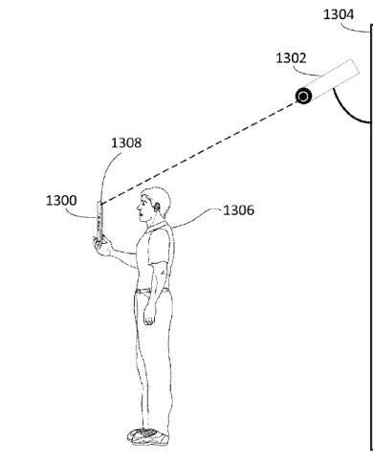
Leveling up your open-source privacy toolset for 2023
Don Marti

Slide 2
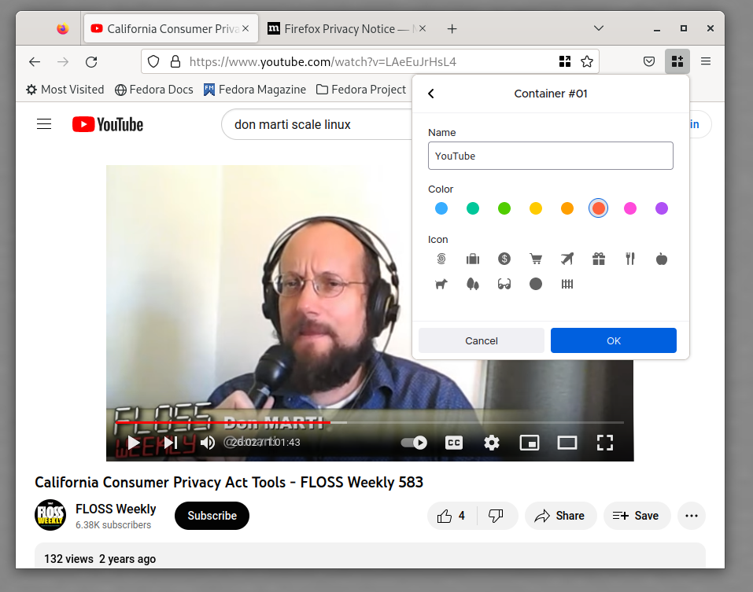

Slide 3
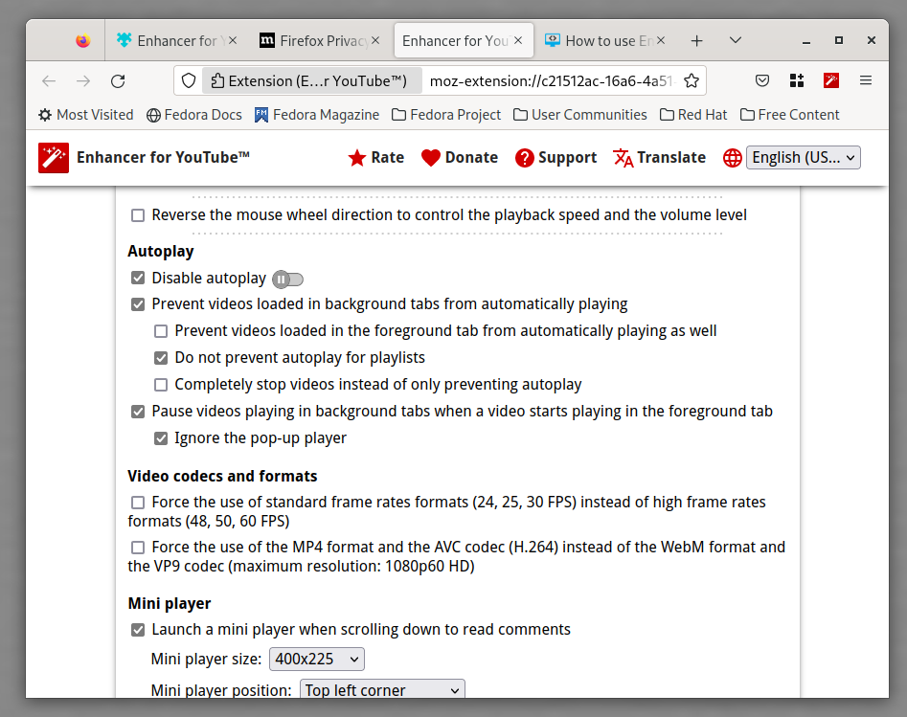

Slide 4
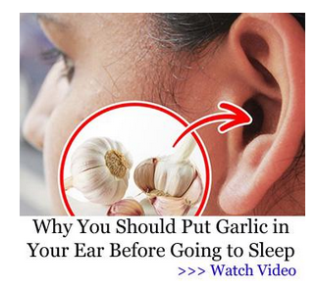

Slide 5
#scamCulture
“From buying a gallon of milk to making a dinner reservation, all the way up the chain to electoral malfeasance, so many of our interactions feel weighted away from social connection in favor of extracting every ounce of unfair advantage from every single human activity. Not to overstate it, but a pluralistic democracy simply cannot function when most of its citizens cannot trust that the arrangements that they rely on to meet their basic needs are roughly fair.”
– Prof. Tressie McMillan Cottom

Slide 6
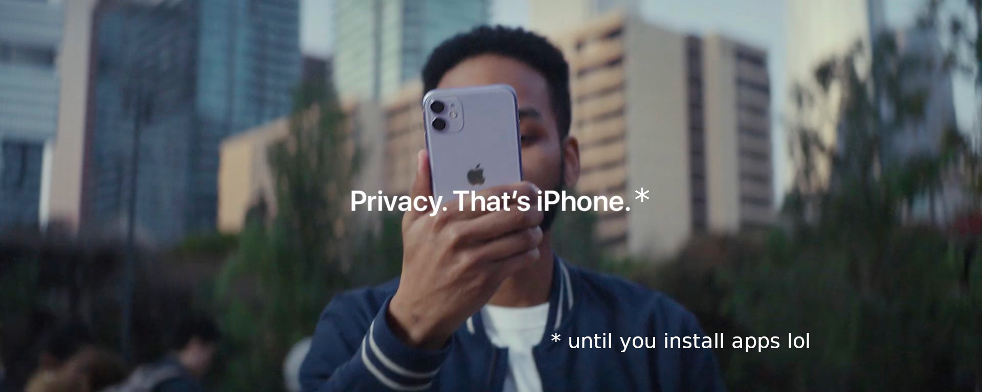

Slide 7
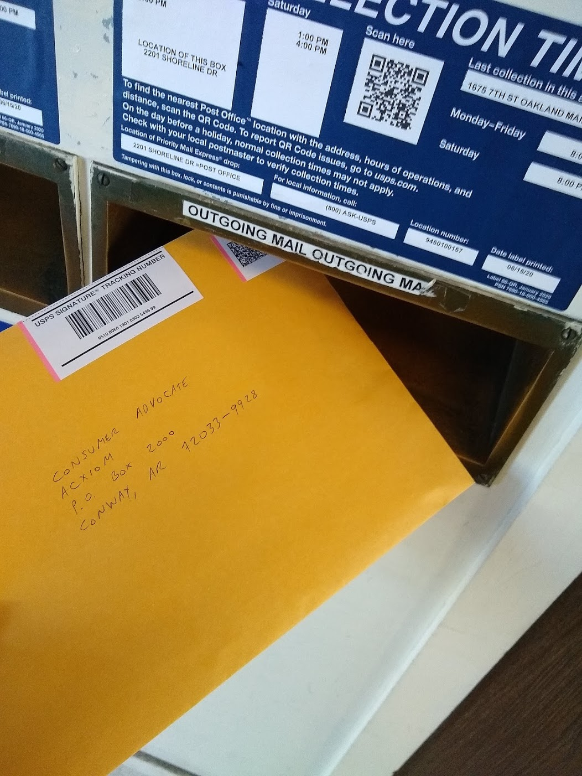

Slide 8


Slide 9
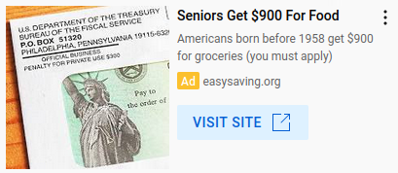

Slide 10
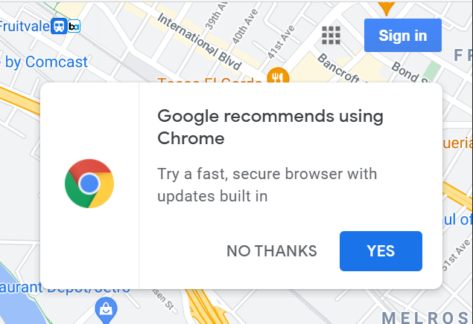

Slide 11
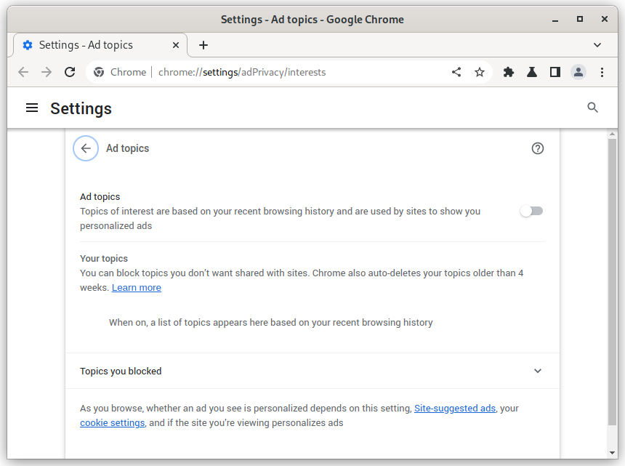

Slide 12
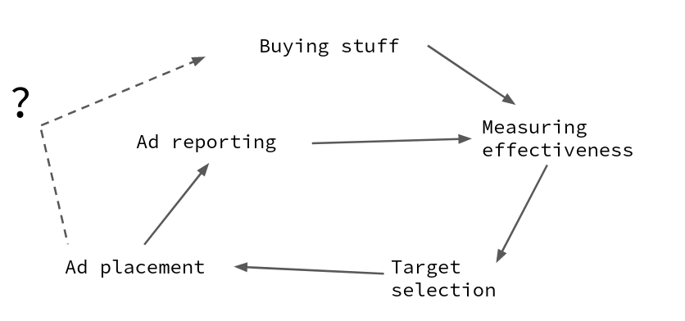

Slide 13
#!/usr/bin/bash
# CCPA disclosure and deletion letters from the command
# line. Just type:
# ccpa privacy@example.com
LETTER=../../../privacy-docs/ccpa-letter.md
TMPFILE=$(mktemp) || exit 1

Slide 14
# Extract your "From" address from your Mutt config
# file, and the "To" from the command-line argument.
FROM=$(egrep '^set from' $HOME/.muttrc | cut -d '=' -f 2 | tr -d '"')
if [ "x$CCPA_EMAIL" == 'x' ]; then
export CCPA_EMAIL=$FROM
fi
if [ "x$CCPA_ADDRESS" == 'x' ]; then
export CCPA_ADDRESS="Address not set. Set CCPA_ADDRESS in your environment."
fi
if [ "x$CCPA_PHONE" == 'x' ]; then
export CCPA_PHONE="Phone not set. Set CCPA_PHONE in your environment."
fi

Slide 15
# Write the headers. The X- header is to help keep
# track of which recipients got which versions.
echo "From: $FROM" > $TMPFILE
echo $SUBJECT >> $TMPFILE
echo "To: $TO" >> $TMPFILE
echo -n "X-CCPA-Content: " >> $TMPFILE
git hash-object $LETTER >> $TMPFILE
# Chop off the front matter from the letter, then
# use the “mo” template tool to include your
# CCPA_EMAIL, CCPA_ADDRESS, and CCPA_PHONE
tail -n +7 $LETTER | mo >> $TMPFILE

Slide 16
# Finally run Mutt
mutt -e "set signature=" -H $TMPFILE
# You can now review and send normally.
# You don’t have to use Mutt as your regular mailer

Slide 17
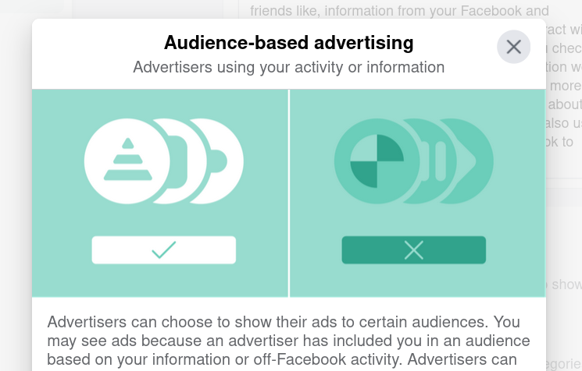

Slide 18
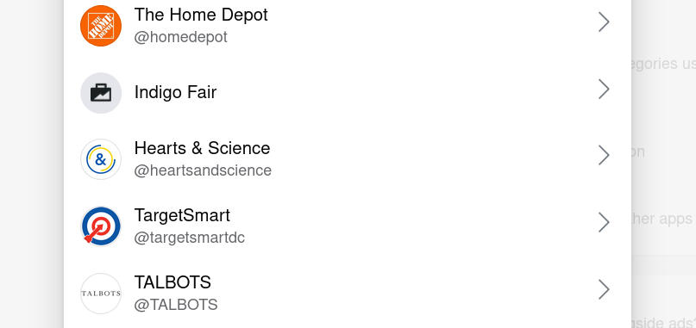

Slide 19
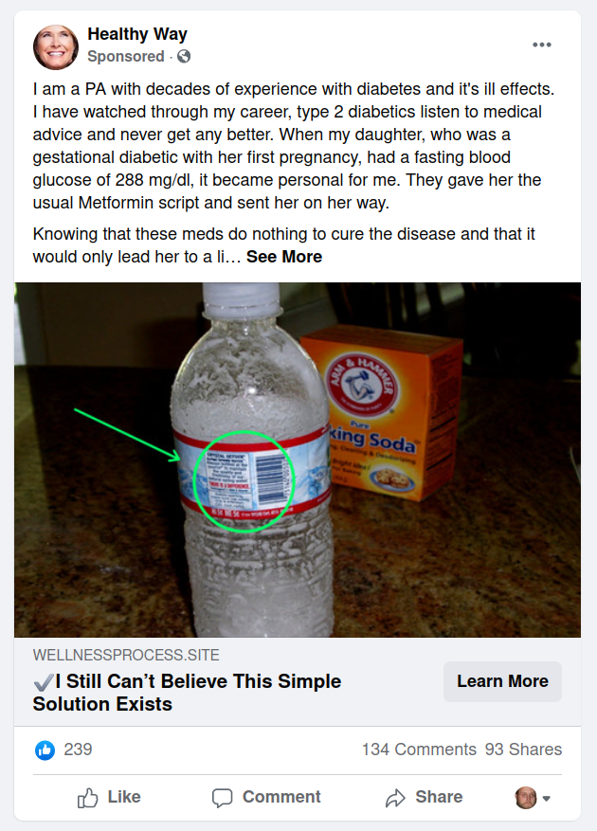

Slide 20
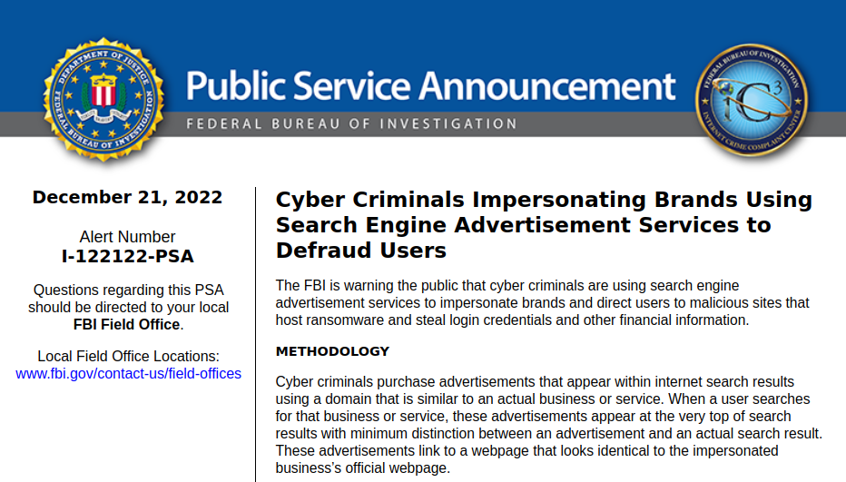

Slide 21
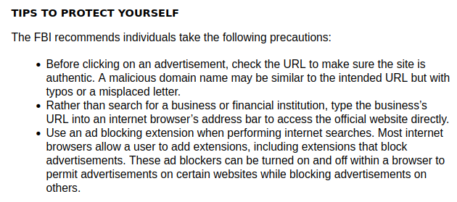

Slide 22
Thank you
Any questions?

